Slide 1
VENUE BOOKING SYSTEM
FEEL THE BEST, ARRANGE THE BEST

Slide 2
PROBLEM-6
The NorthCap university intends to develop a Venue Booking System. To facilitate this, a new application needs to be developed, where a Faculty should be able to book a Venue, edit a booking and Delete a Booking

Slide 3
CONTENTS
Index.HTML imported scripts, Homepage and basic components
DOD’s
Day 1 (Basic Website Layout with responsiveness)
Day 2 (Admin Page with Authorization & Linked to Faculty Records Page)
Day 3 (Routing of different components with highlighting and sorting)
Day 4 (Styling records table: Edit/Delete Components)
Day 5 (Final touches, working on PowerPoint Presentation)

Slide 4
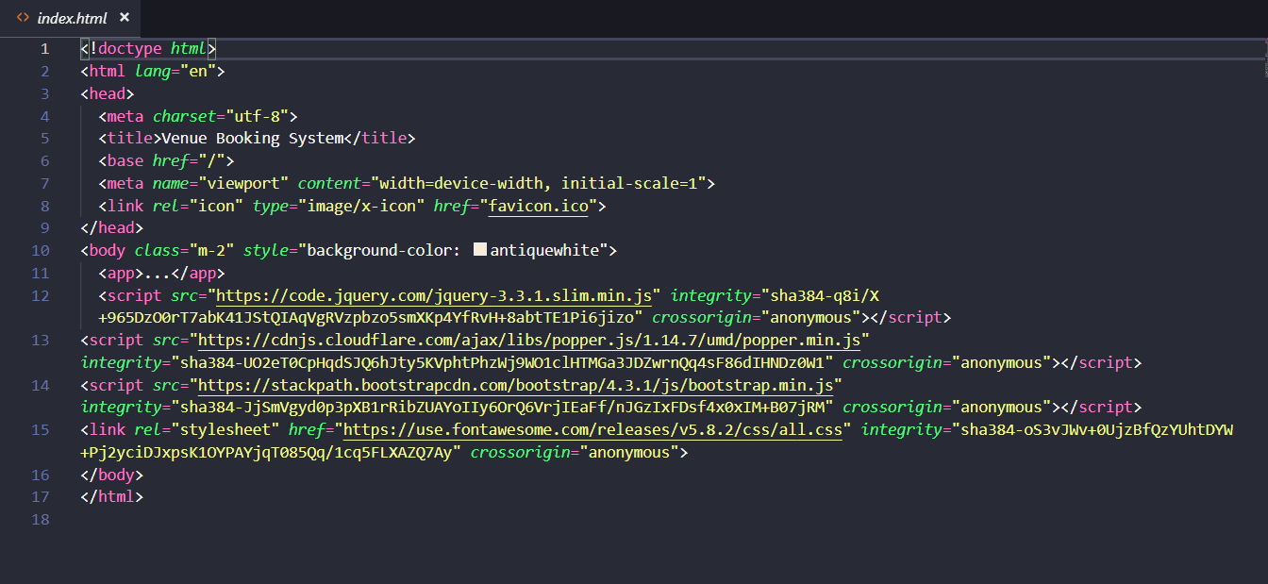
Basic layout with scripts

Slide 5
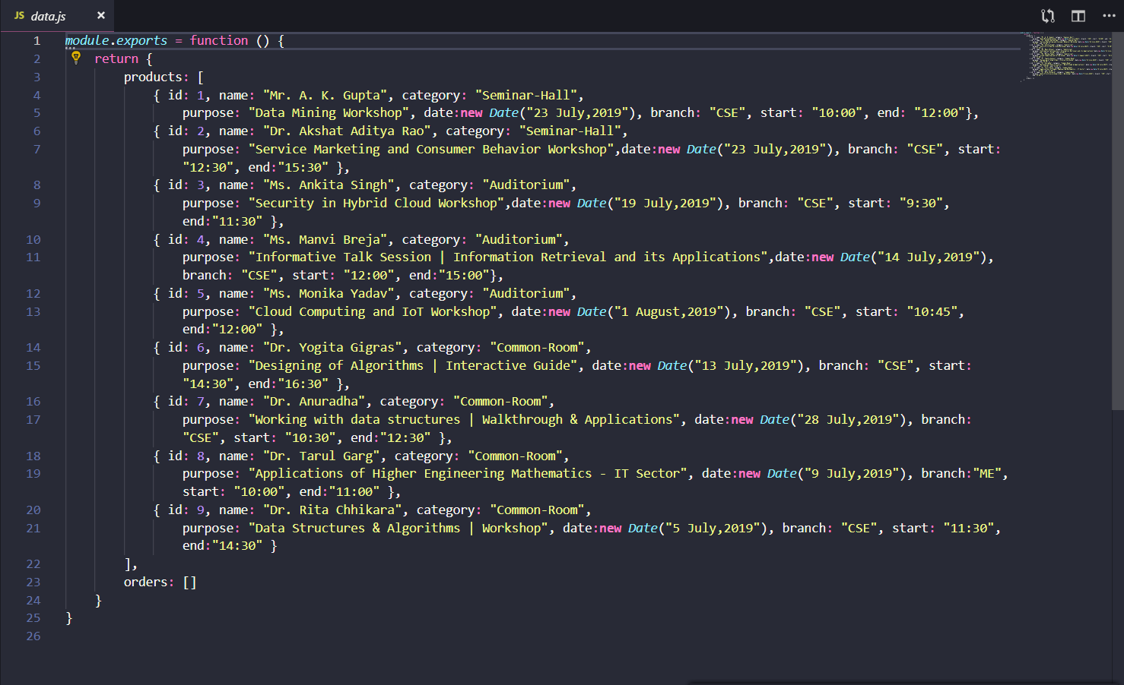
Json file

Slide 6
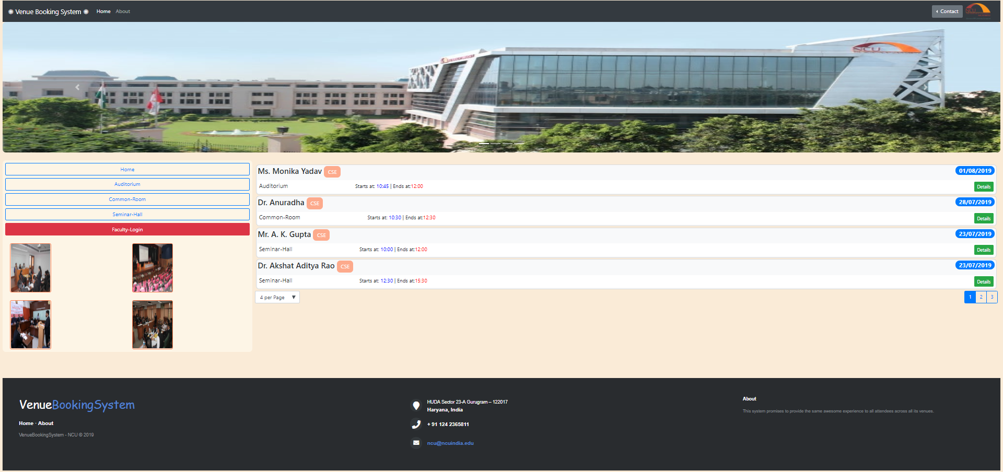
homepage

Slide 7
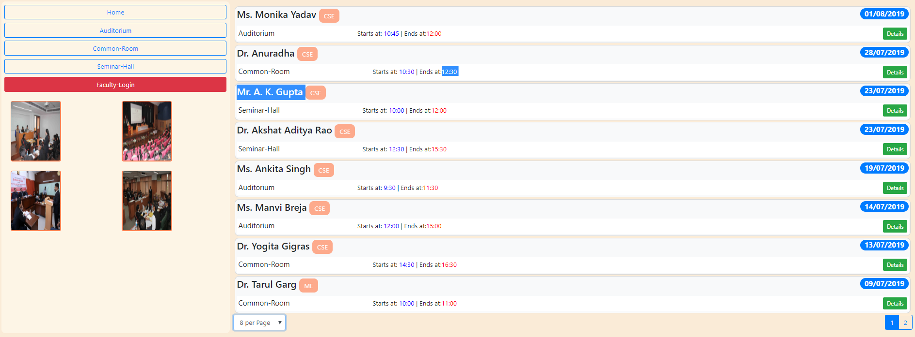
Homepage should display a list of all the venues

Slide 8
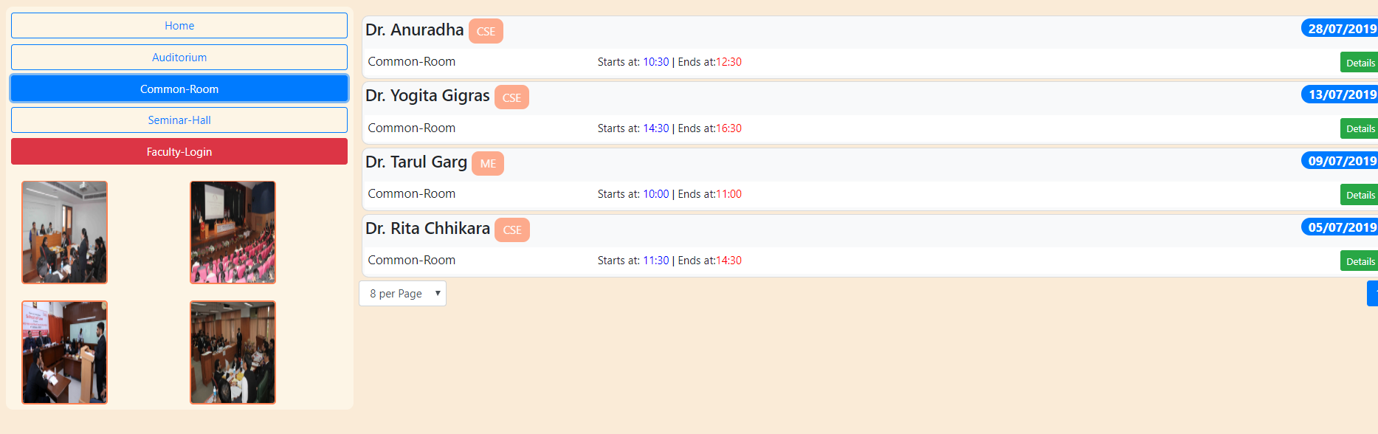
Upon selecting any venue, a list of all the bookings should be displayed in decreasing order

Slide 9
The booking record should contain the below mentioned fields
Venue Name (required, unique)
Faculty Name (required)
Branch (CSE, ECE, ME or CIVIL) (required)
Date of Booking (required)
Start time (required)
End time (required)
Purpose

Slide 10

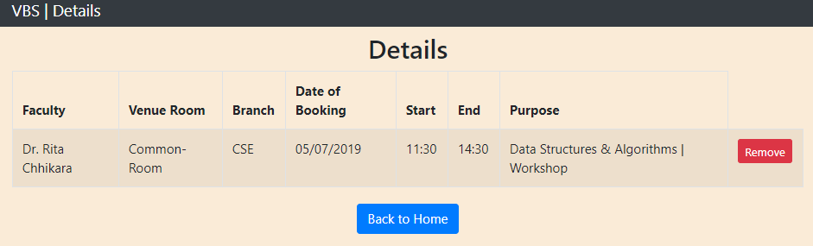
Upon selecting any booking, booking details should be displayed along with the facility to cancel the booking. Same should be in homepage

Slide 11
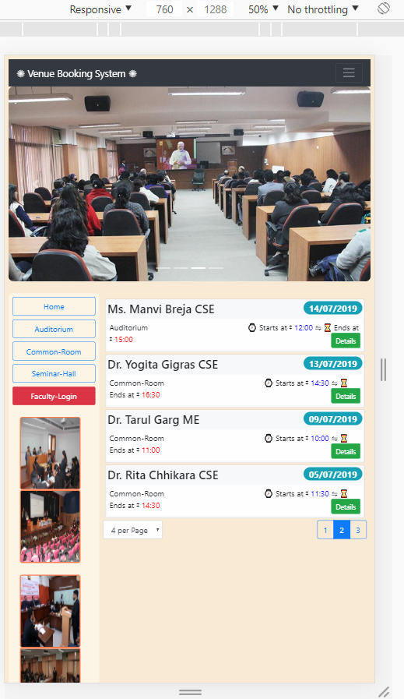
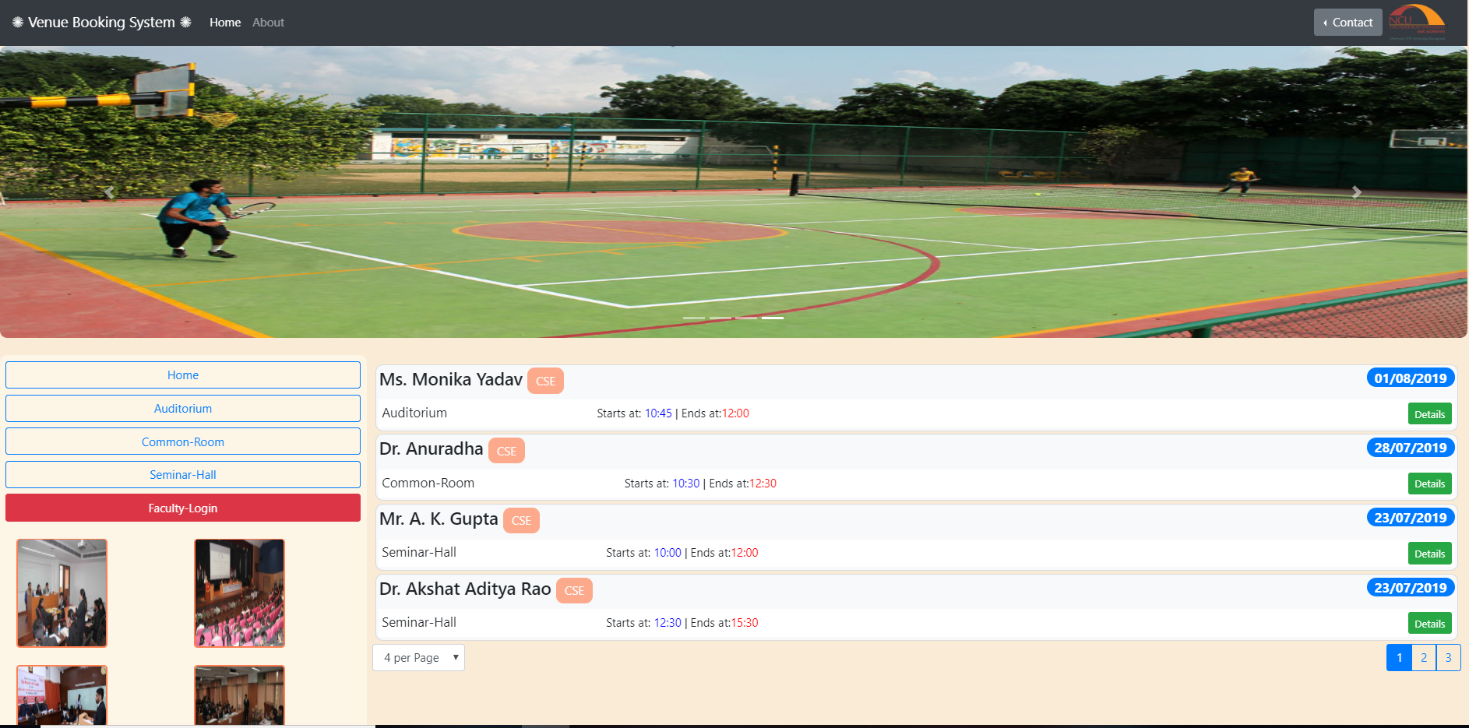
DAY 1
WE MADE THE BASIC STRUCTURE OF WEBPAGE
OUR BASIC HOMEPAGE LAYOUT WITH STYLING AND ALONG WITH RESPONSIVENESS

Slide 12
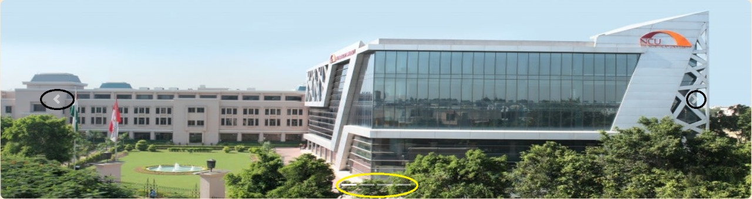

Carousel
Also added a few bootstrap components like navbar,carousel

Slide 13
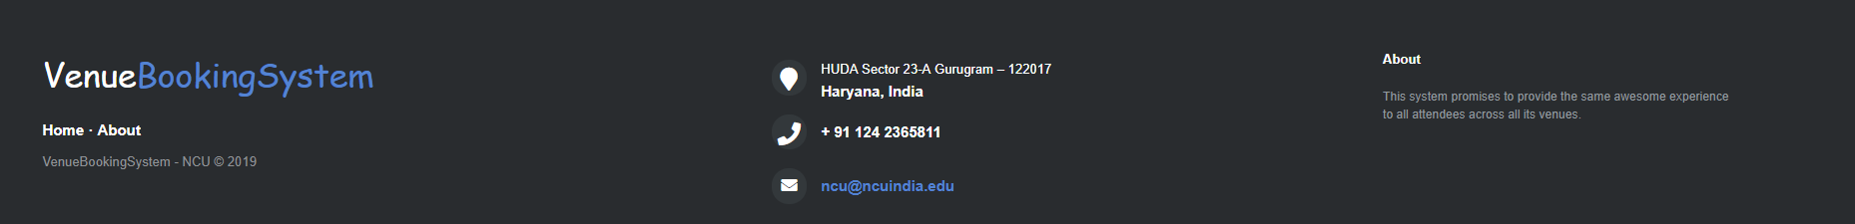
FOOTER
Created a footer to provide a better look to the webpage

Slide 14
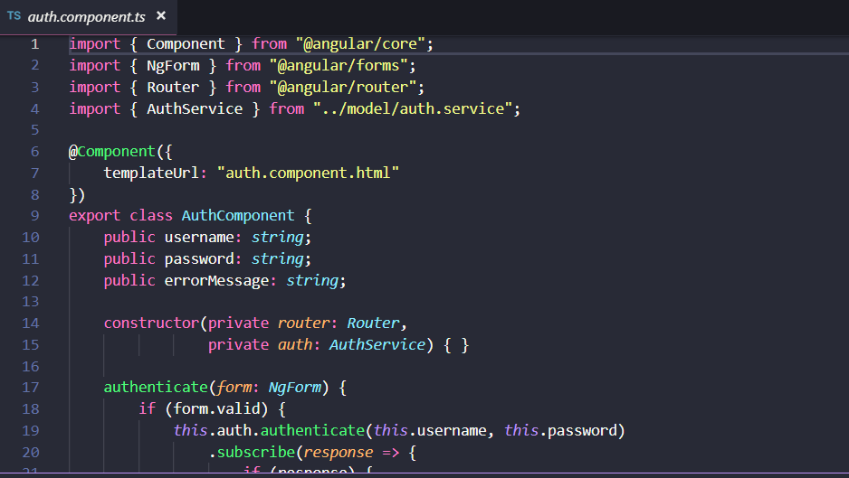
DAY 2
Designed the admin page along with necessary authorization
Further we linked it to the Faculty Record’s Page, where the Faculty has the access to Modifying and Booking a Venue.

Slide 15
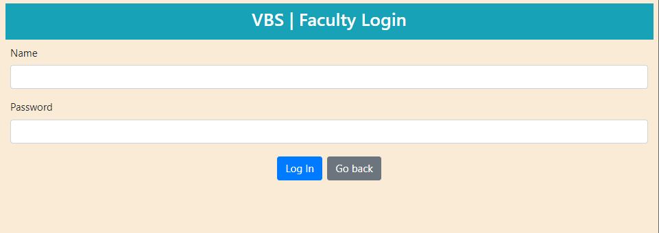
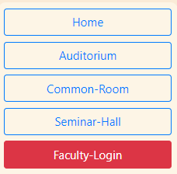
Homepage should also contain the faculty login facility

Slide 16
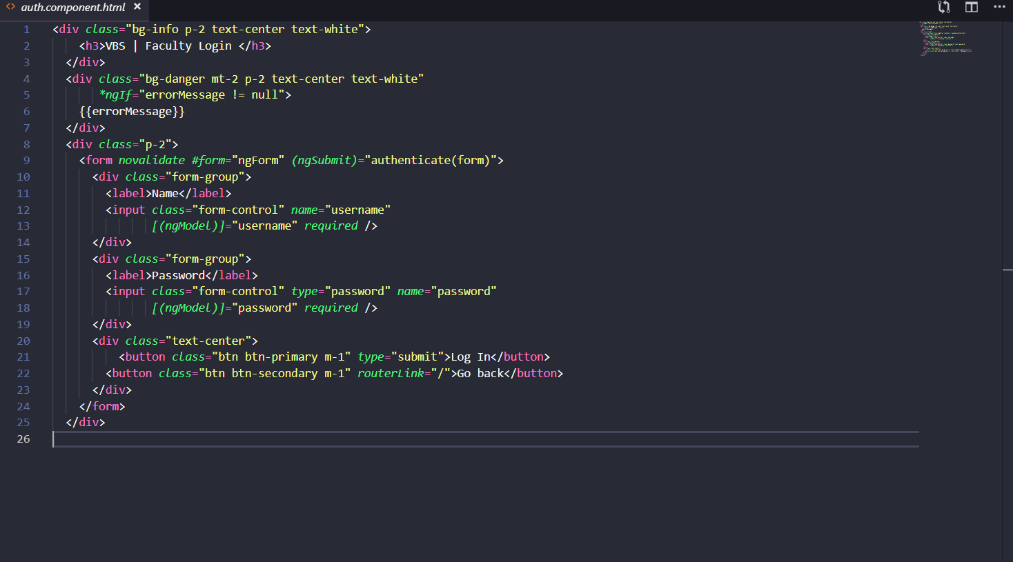
HTML CODE FOR AUTH.COMPONENT (LOGIN PAGE)

Slide 17
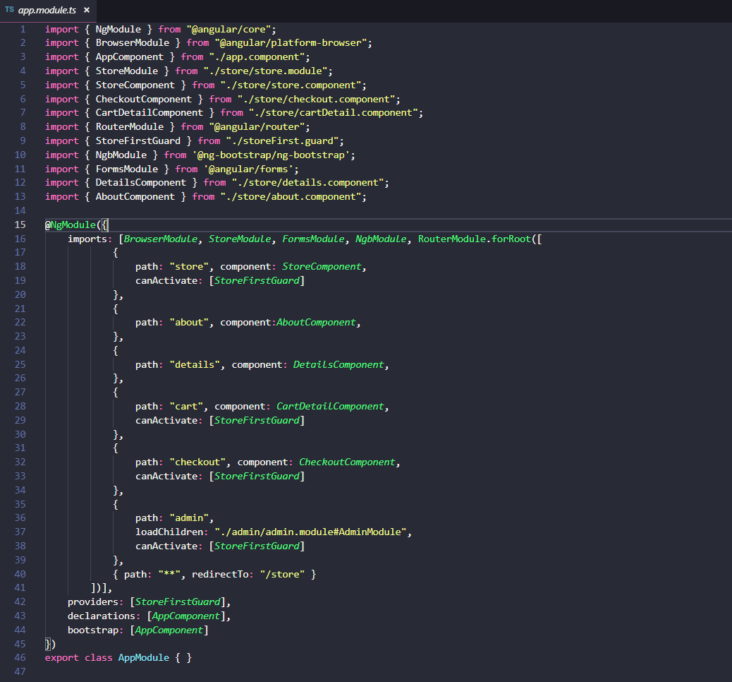
Day-3
ADDED ROUTING TO DIFFERENT COMPONENTS
ALSO COMPLETED THE FOLLOWING DOD’S
Highlight Booking, when event has already occurred
Sorting of the Booking Dates in Decreasing order

Slide 18
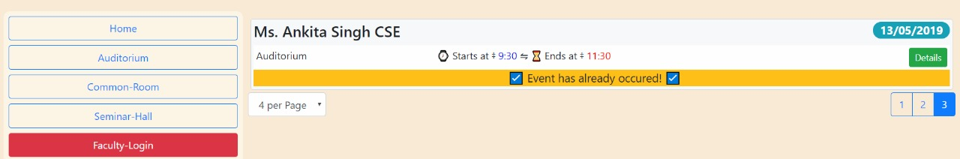
Booking should be made before the current date , where the event has already occurred, should be highlighted

Slide 19
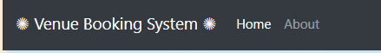
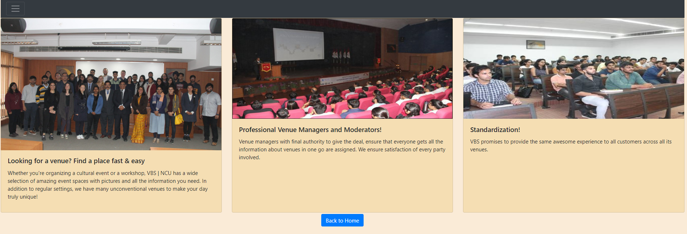
ADDING MORE DETAILS
We also linked two components: details and about page using routing

Slide 20
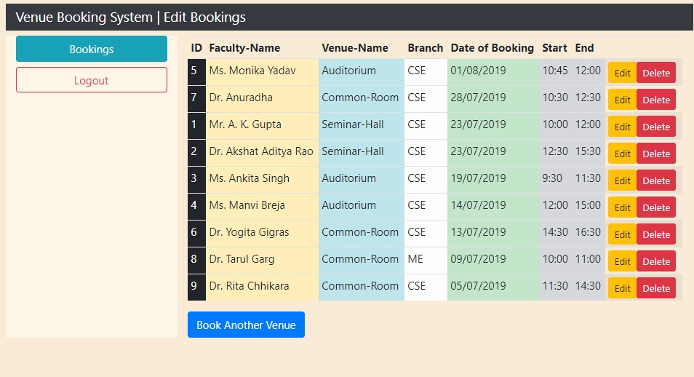
Day - 4
A faculty can add, update and delete any booking information
yling recStords table component (edit, delete, booking)

Slide 21
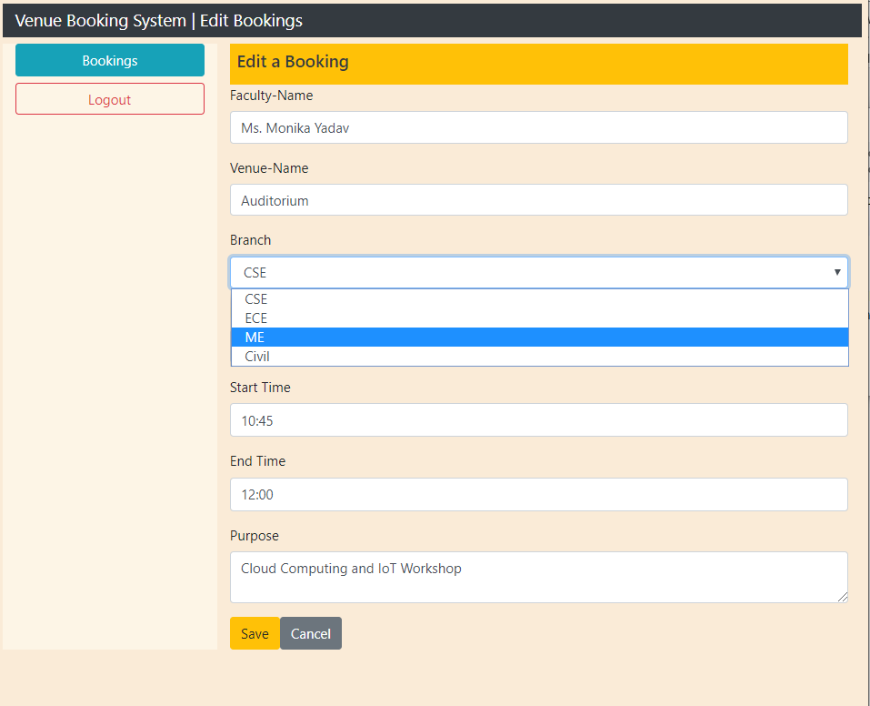
Editing a venue

Slide 22
Usage of different code blocks

Slide 23
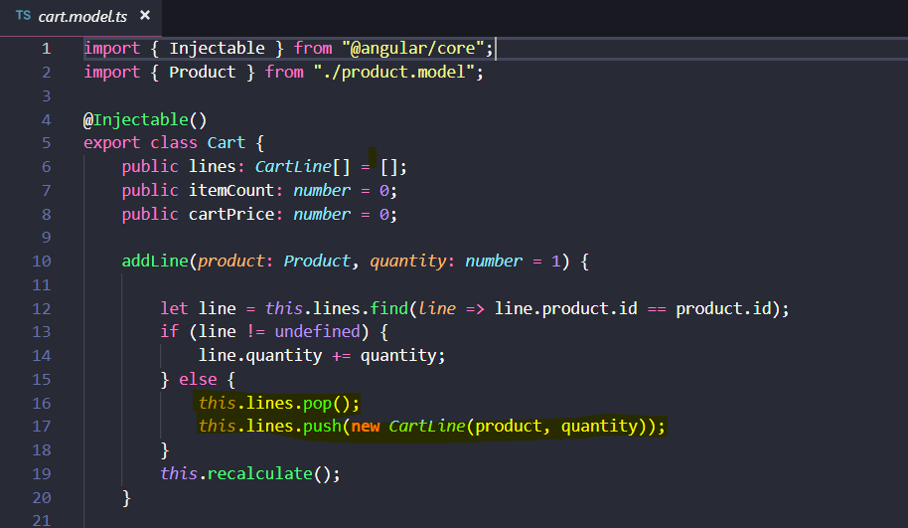
HIGHLIGHTED CODE: VIEW DETAILS

Slide 24
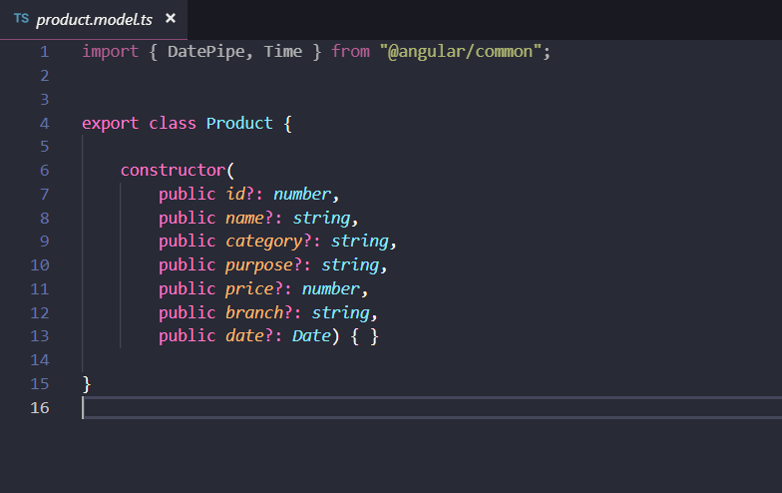
CONSTRUCTOR WITH VARIABLES WHICH IS EXPORTED

Slide 25
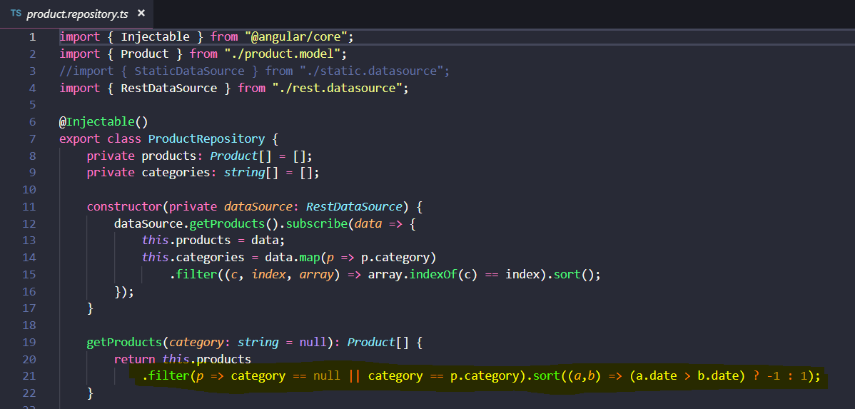
HIGHLIGHTED CODE: SORTING IN DESCENDING ORDER

Slide 26
THANK YOU!
MANDEEP SINGH (17CSU100)

